Slide 1
Video 4
Sub Queries and Common Table Expressions

Slide 2
Why Sub Queries and Common Table Expressions
Transaction_id | Product_id | City | Amount
1 | A01 | Chicago | 200
2 | A02 | New York | 150
3 | Z02 | New York | 600
.. | .. | …
Transactions

Slide 3
Why Sub Queries and Common Table Expressions
Transaction_id | Product_id | City | Amount
1 | A01 | Chicago | 200
2 | A02 | New York | 150
3 | Z02 | New York | 600
.. | .. | …
select city, sum(amount) as total
from transactions
group by city
order by total desc
Transactions

Slide 4
Why Sub Queries and Common Table Expressions
Transaction_id | Product_id | City | Amount
1 | A01 | Chicago | 200
2 | A02 | New York | 150
3 | Z02 | New York | 600
.. | .. | …
select city, sum(amount) as total
from transactions
group by city
order by total desc
Transactions
City | Amount
New York | 18000
Chicago | 16500
… | …

Slide 5
Why Sub Queries and Common Table Expressions
Transaction_id | Product_id | City | Amount
1 | A01 | Chicago | 200
2 | A02 | New York | 150
3 | Z02 | New York | 600
.. | .. | …
select city, sum(amount) as total
from transactions
group by city
order by total desc
Transactions
City | Amount
New York | 18000
Chicago | 16500
… | …
What if we wan to bin this amount into high, medium and low categories?

Slide 6
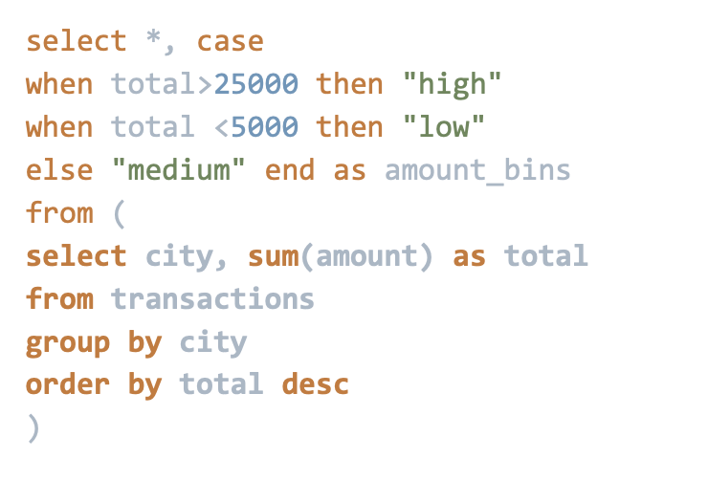
Outer Query
Inner Query

